Slide 1
Fluid Mechanics Class Note
Dr. Qassem Hamed Jalut Associate Professor
Fluid Static

Slide 2
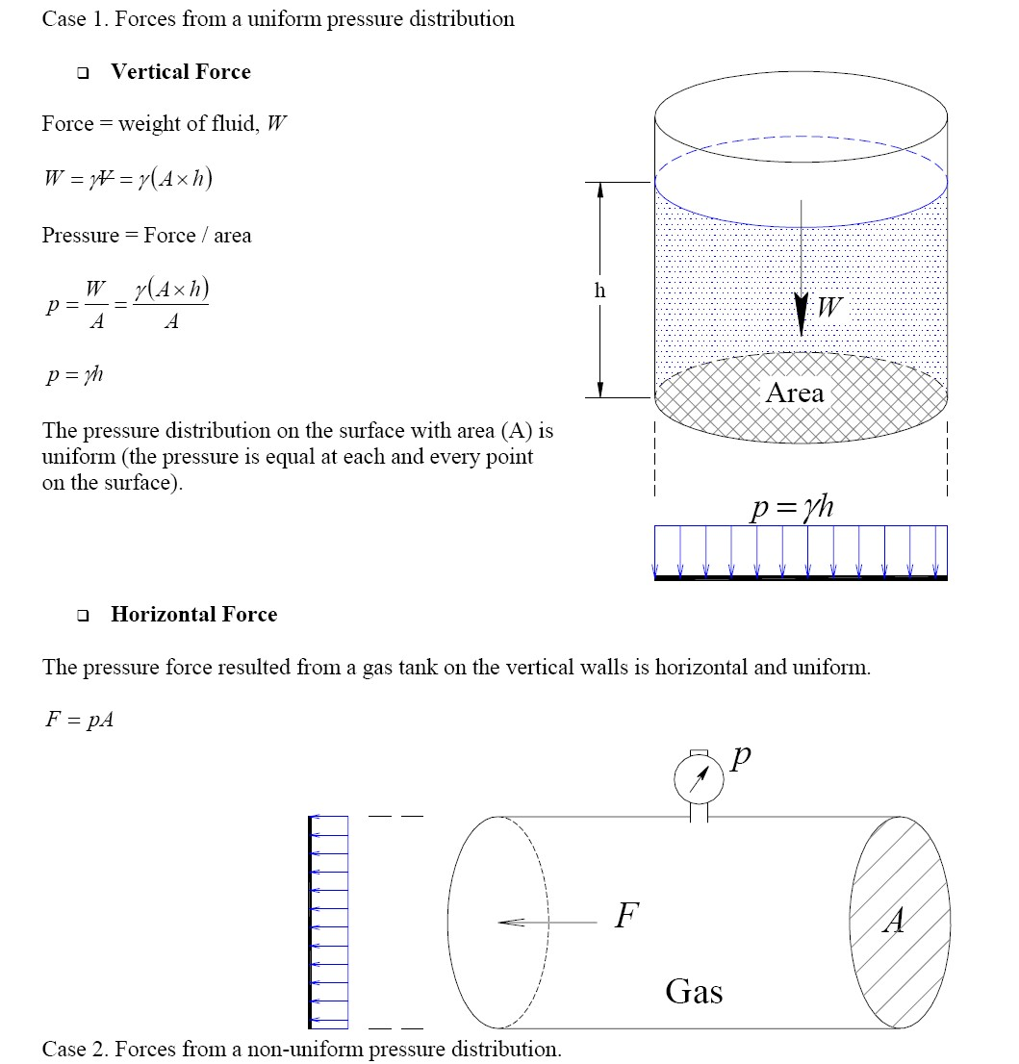
Fluid Mechanics Class Note
Dr. Qassem Hamed Jalut Associate Professor

Slide 3
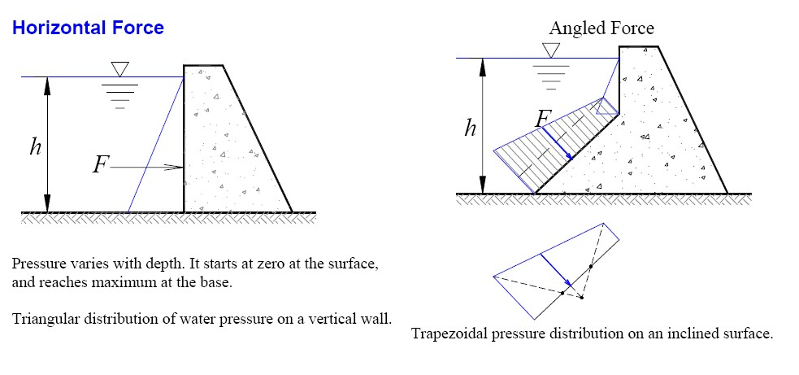
Fluid Mechanics Class Note
Dr. Qassem Hamed Jalut Associate Professor

